Slide 1
Denoising Diffusion Implicit Models
ICLR 2021
Jiaming Song, Chenlin Meng, Stefano Ermon
Presented by Beomsoon Park
C&I LAB

Slide 2
Contents
Introduction
Background
Variational Inference For Non-Markovian Forward Process
Sampling From Generalized Generative Processes
Experiments
C&I LAB

Slide 3
Introduction
C&I LAB

Slide 4
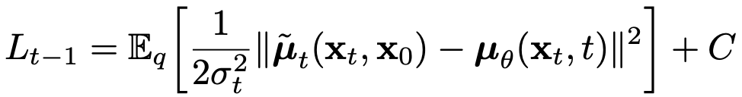
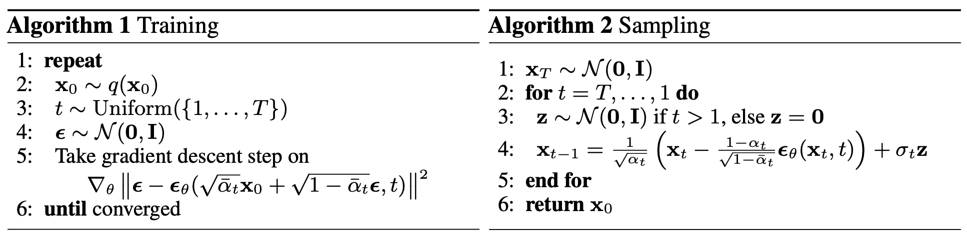
Introduction
DDPM (Recap)
C&I LAB

Slide 5
Introduction
DDPM (Recap)
Markovian Inference Process
Require many steps
to generate high quality samples
C&I LAB

Slide 6
Introduction
Drawbacks of DDPM
DDPM
Around 20 hours
To sample 50K 32 X 32 images..
BigGAN
Less than 1 minute
Nearly 1000 hours have taken to sample 50K 256 X 256 images..
Very low performance in terms of sampling efficiency
C&I LAB

Slide 7
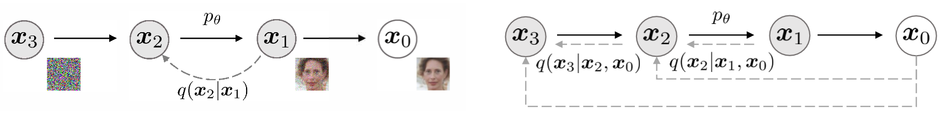
Introduction
Idea for DDIM
Generalization of the forward process to non-Markovian process
Corresponding reverse diffusion process leads to short generative Markov chains
C&I LAB

Slide 8
Background
C&I LAB

Slide 9
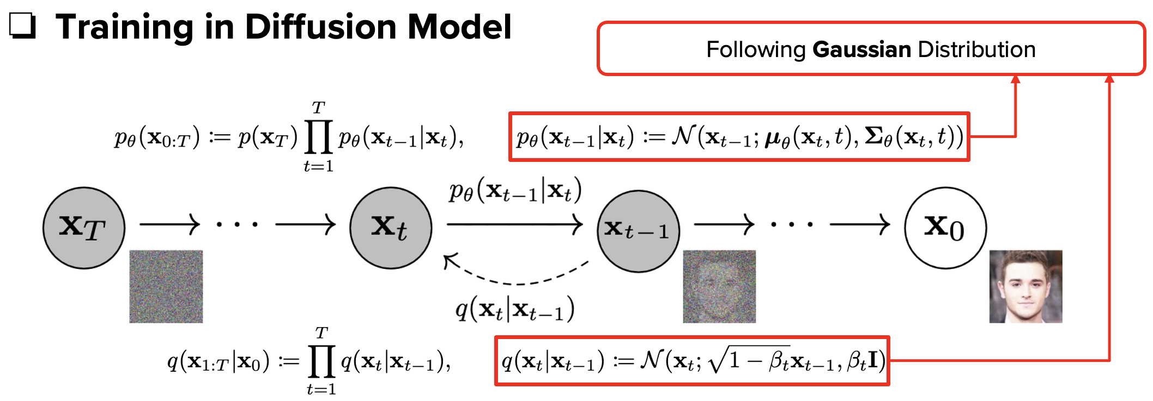
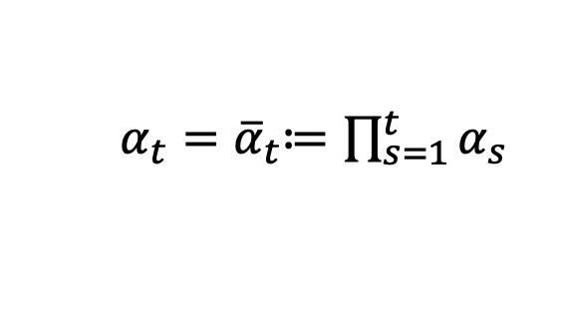
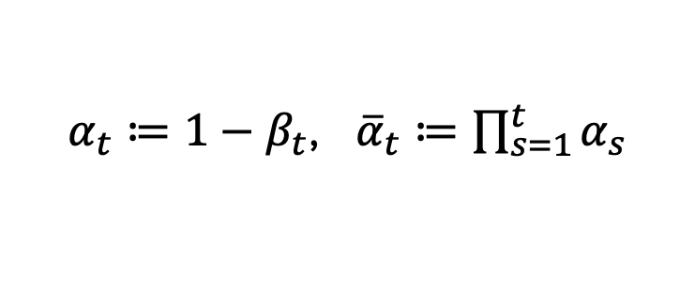
Background
Notation
DDPM
DDIM
$α_{t}≔1−β_{t}$, ${\overline{α}}_{t}≔\prod_{s=1}^{t}{α_{s}}$
$α_{t}{=\overline{α}}_{t}≔\prod_{s=1}^{t}{α_{s}}$
C&I LAB

Slide 10
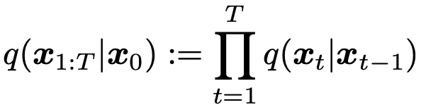
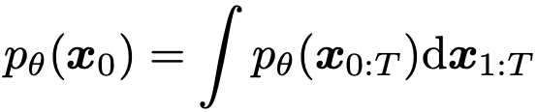
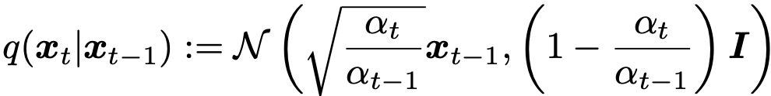
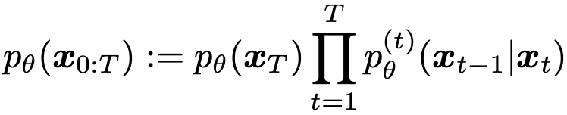
Background
DDPM Objective
C&I LAB

Slide 11
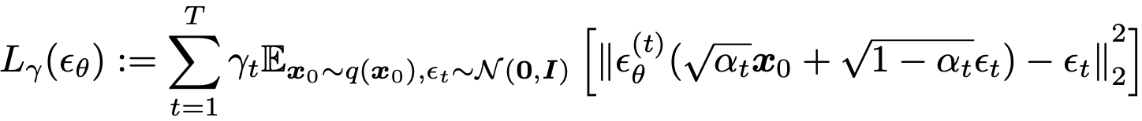
Background
DDPM Objective
C&I LAB

Slide 12
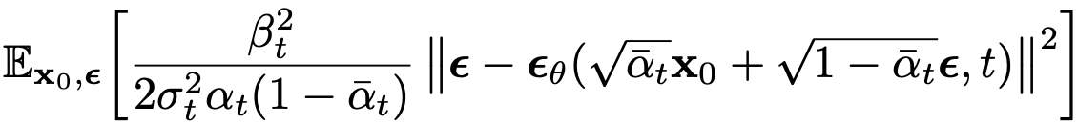


Background
DDPM Objective
$$γ>0,γ≠1$$
$$γ=1$$
Better Performance
T should be large enough to make good approximation → Slow Sampling
C&I LAB

Slide 13
Variational Inference For Non-Markovian Forward Processes
C&I LAB

Slide 14
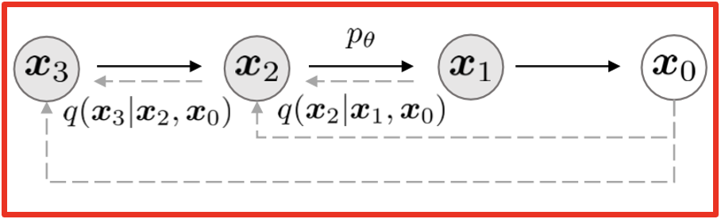
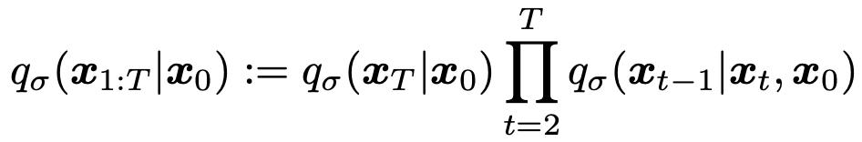
Variational Inference For Non-Markovian Forward Processes
Non-Markovian Forward Processes
Forward Process
consisting of non-Markovian terms
C&I LAB

Slide 15
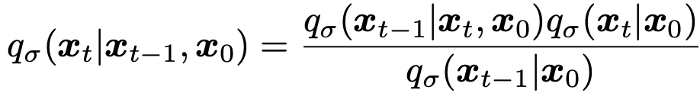
Variational Inference For Non-Markovian Forward Processes
Non-Markovian Forward Processes
C&I LAB

Slide 16
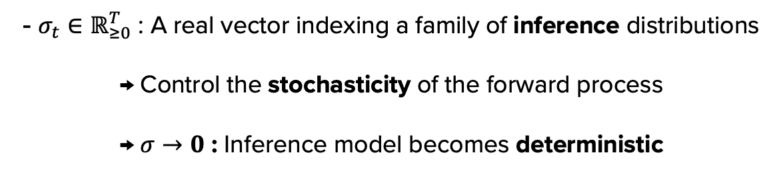
Variational Inference For Non-Markovian Forward Processes
Non-Markovian Forward Processes
- $σ_{t}∈ℝ_{≥0}^{T}$ : A real vector indexing a family of inference distributions
→ Control the stochasticity of the forward process
→ $σ→0$ : Inference model becomes deterministic
C&I LAB

Slide 17
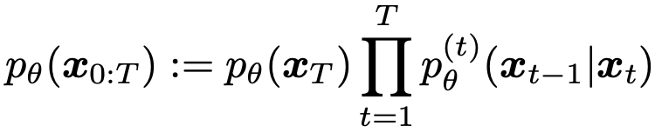
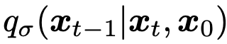
Variational Inference For Non-Markovian Forward Processes
Generative Process
Prediction of the corresponding $x_{0}$ in $q_{σ}(x_{t−1}|x_{t},x_{0})$ with given $x_{t}$
Perform Sampling with $p_{θ}^{\left(t\right)}(x_{t−1}|x_{t})$
C&I LAB

Slide 18
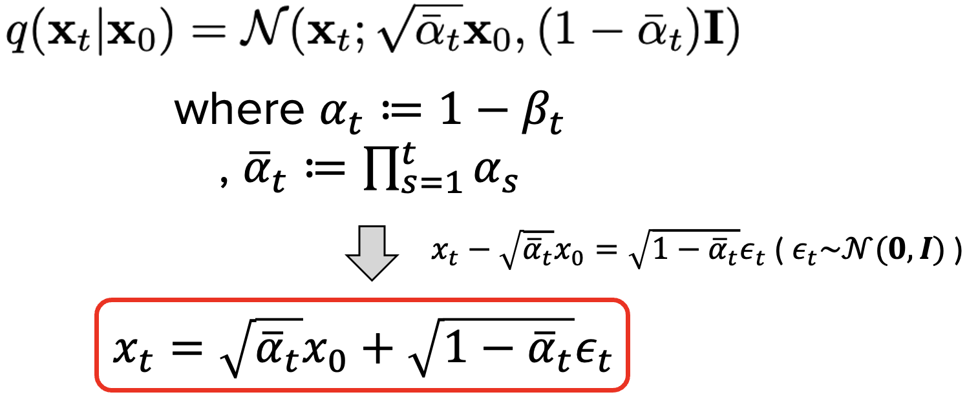

Variational Inference For Non-Markovian Forward Processes
Generative Process
Prediction of $x_{0}$
Denoised Observation
(Predicted $x_{0}$)
C&I LAB

Slide 19
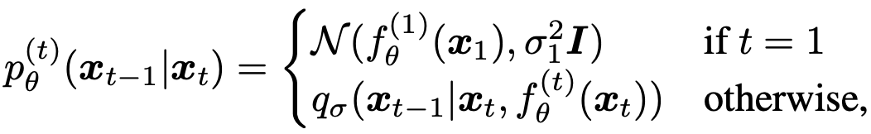
Variational Inference For Non-Markovian Forward Processes
Generative Process
Add Gaussian Noise
→ Help generative process cover the entire data space
C&I LAB

Slide 20
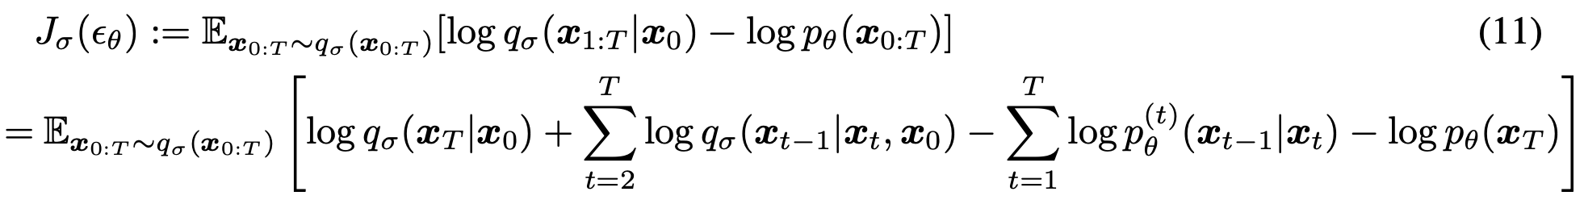
Variational Inference For Non-Markovian Forward Processes
Unified Variational Inference Objective
Difference between
non-Markovian forward process & corresponding reverse process
C&I LAB

Slide 21
Variational Inference For Non-Markovian Forward Processes
Unified Variational Inference Objective
C&I LAB

Slide 22
Variational Inference For Non-Markovian Forward Processes
Unified Variational Inference Objective
Optimal Solution for $ε_{θ}$ does not depend on the weight $γ$
→ $L_{1}$ objective is suitable to obtain optimal solution for $ε_{θ}$
$J_{σ}$ is equivalent to some $L_{γ}$ by Theorem 1
→ $J_{σ}$ objective can be substituted with $L_{1}$ objective
DDIM Objective = DDPM Objective
C&I LAB

Slide 23
Sampling From Generalized Generative Processes
C&I LAB

Slide 24
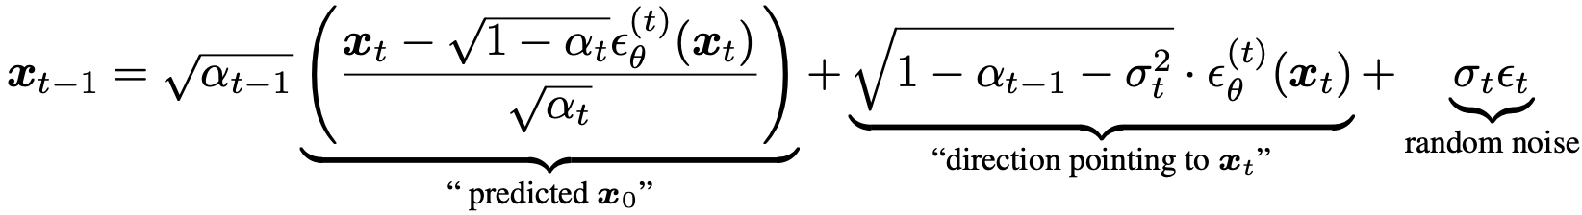
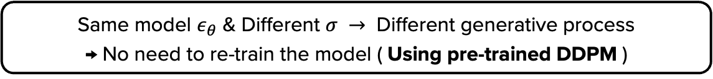
Sampling From Generalized Generative Processes
Denoising Diffusion Implicit Models
Same model $ε_{θ}$ & Different $σ →$ Different generative process
→ No need to re-train the model ( Using pre-trained DDPM )
C&I LAB

Slide 25
Sampling From Generalized Generative Processes
Denoising Diffusion Implicit Models
Forward Process → Markovian
Generative Process → DDPM
C&I LAB

Slide 26
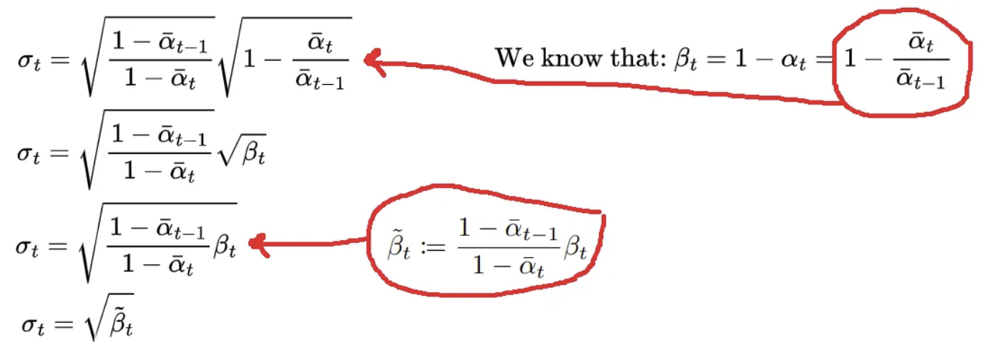
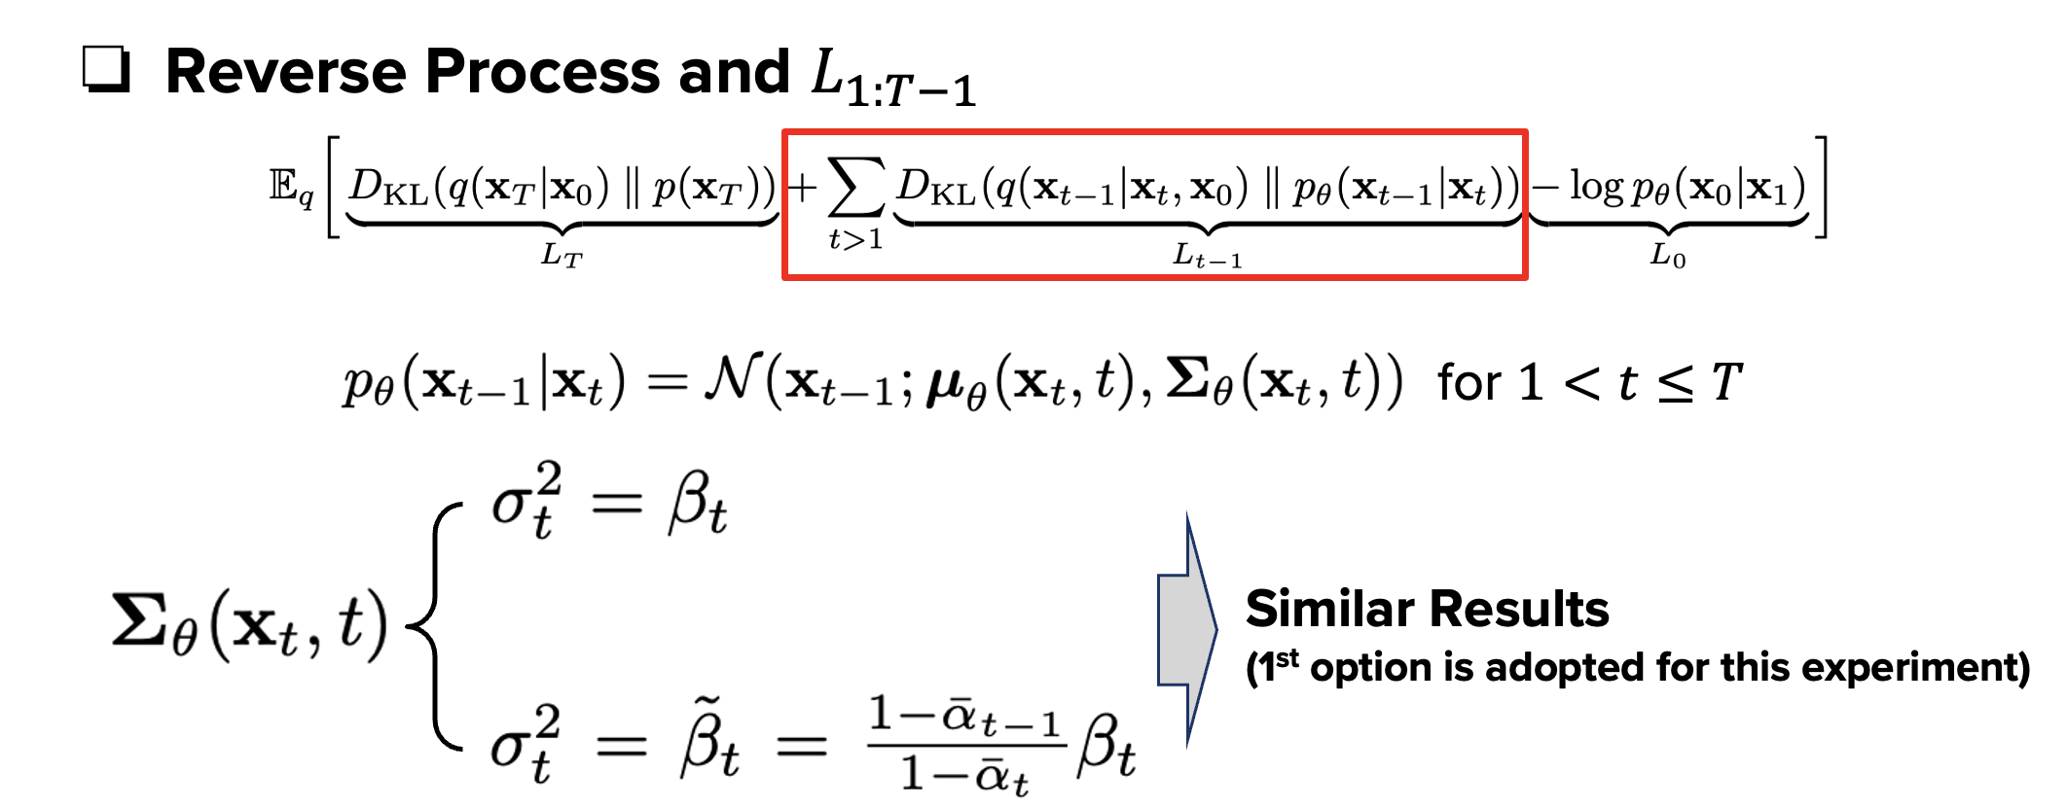
Sampling From Generalized Generative Processes
Denoising Diffusion Implicit Models
https://betterprogramming.pub/diffusion-models-ddpms-ddims-and-classifier-free-guidance-e07b297b2869#d8a1
C&I LAB

Slide 27
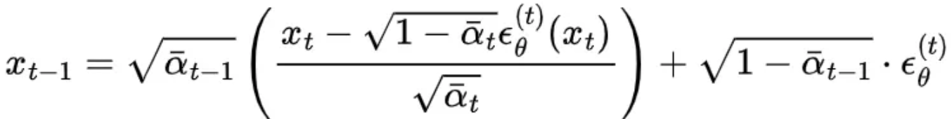
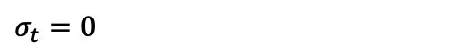
Sampling From Generalized Generative Processes
Denoising Diffusion Implicit Models
$$σ_{t}=0$$
DDIM
https://betterprogramming.pub/diffusion-models-ddpms-ddims-and-classifier-free-guidance-e07b297b2869#d8a1
C&I LAB

Slide 28
Sampling From Generalized Generative Processes
Denoising Diffusion Implicit Models
DDIM
Forward process becomes deterministic with given $x_{t−1}$ and $x_{0}$
Samples are generated from latent variables with a fixed procedure
https://betterprogramming.pub/diffusion-models-ddpms-ddims-and-classifier-free-guidance-e07b297b2869#d8a1
C&I LAB

Slide 29
Sampling From Generalized Generative Processes
Accelerated Generation Processes
Fixed $q_{σ}(x_{t}|x_{0})$ → $L_{1}$ : No dependency on any forward procedure
Forward processes with shorter lengths could be considered
Corresponding generative processes could be accelerated
C&I LAB

Slide 30
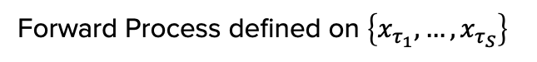


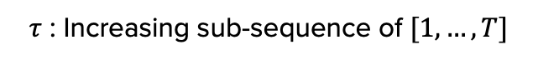
Sampling From Generalized Generative Processes
Accelerated Generation Processes
Forward Process defined on $\left\{x_{τ_{1}}, …,x_{τ_{S}}\right\}$
$τ$ : Increasing sub-sequence of $[1,…,T]$
$$q\left(x_{τ_{i}} | x_{0}\right)=𝒩(\sqrt{α_{τ_{i}}}x_{0},\left(1−α_{τ_{i}}\right)I)$$
$$≒q\left(x_{t} | x_{0}\right)=𝒩(\sqrt{α_{t}}x_{0},\left(1−α_{t}\right)I)$$
C&I LAB

Slide 31
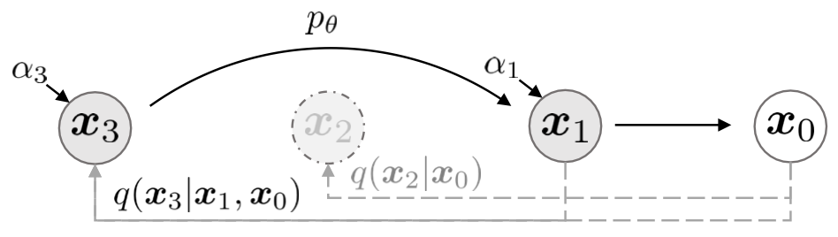

Sampling From Generalized Generative Processes
Accelerated Generation Processes
Sampling Trajectory
Modified Forward Process
$$τ=[1,3]$$
C&I LAB

Slide 32
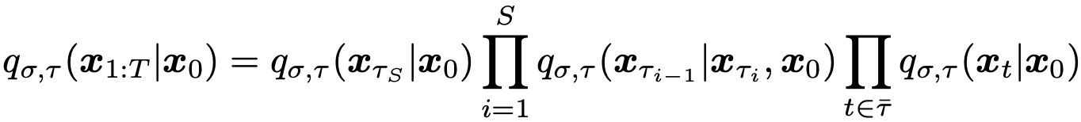
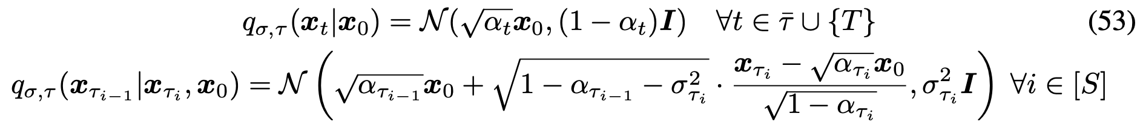
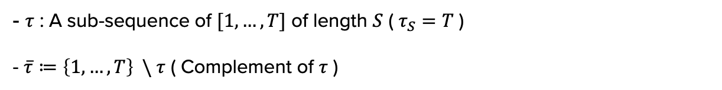
Sampling From Generalized Generative Processes
Accelerated Generation Processes (Forward Process)
- $τ$ : A sub-sequence of $[1,…,T]$ of length $S$ ( $τ_{S}=T$ )
- $\overline{τ}≔\left\{1,…,T\right\} \backslash τ$ ( Complement of $τ$ )
Designed to satisfy
C&I LAB

Slide 33
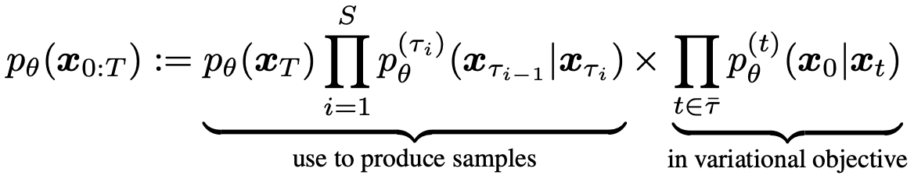
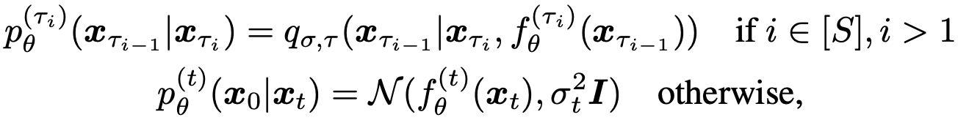
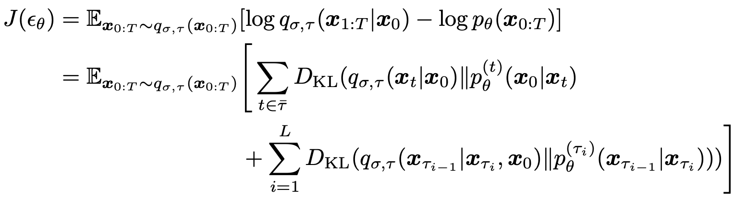
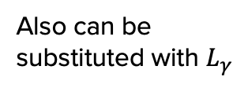
Sampling From Generalized Generative Processes
Accelerated Generation Processes (Generative Process)
Also can be
substituted with $L_{γ}$
DDPM Objective
C&I LAB

Slide 34
Experiments
C&I LAB

Slide 35
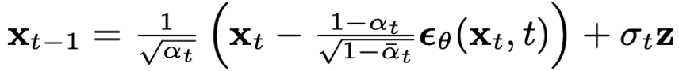
Experiments
DDPM vs DDIM
Stochastic
DDPM
Many
iterations
Slow
Deterministic
DDIM
Cost-efficient
https://betterprogramming.pub/diffusion-models-ddpms-ddims-and-classifier-free-guidance-e07b297b2869#d8a1
C&I LAB

Slide 36
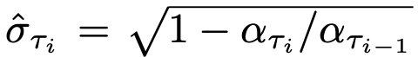
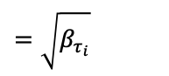

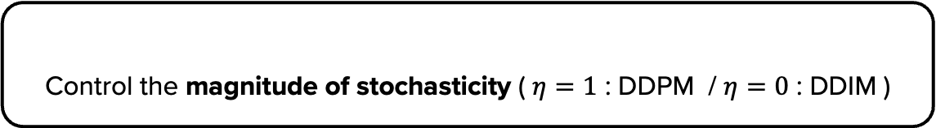
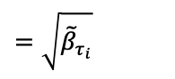
Experiments
Initial Settings
Same Trained Model with T = 1000, $L_{γ}$ objective with $γ=1$
No update on training procedure
Control the magnitude of stochasticity ( $η=1$ : DDPM / $η=0$ : DDIM )
$$=\sqrt{{\tilde{β}}_{τ_{i}}}$$
DDPM with higher standard deviation than $σ(1)$
$$=\sqrt{β_{τ_{i}}}$$
C&I LAB

Slide 37
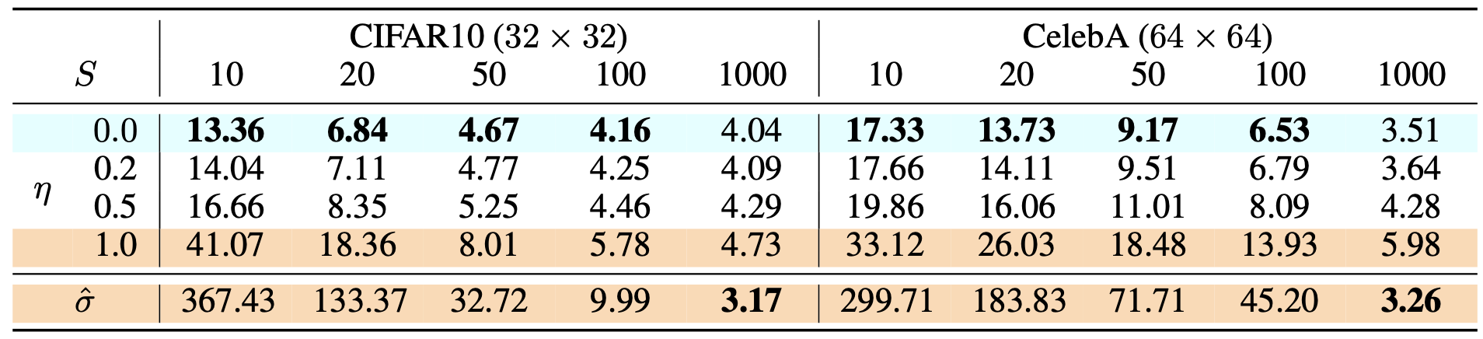
Experiments
Image Generation measured in FID
DDIM
DDPM
C&I LAB

Slide 38
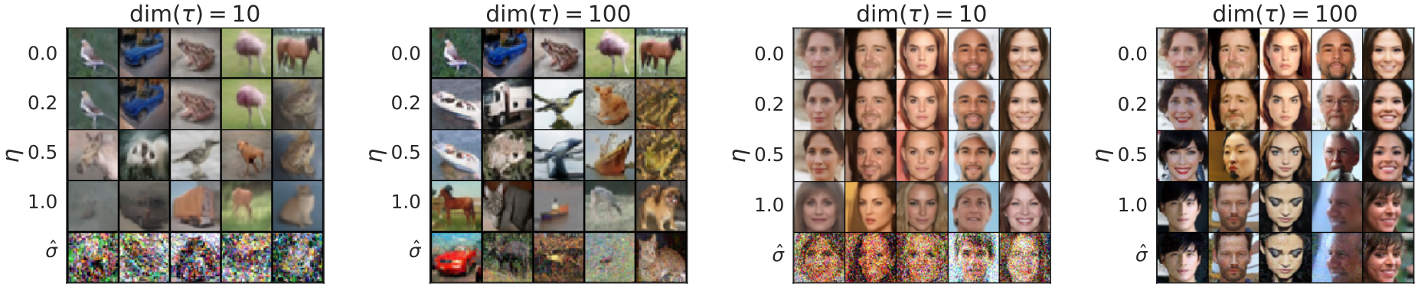
Experiments
Image Generation measured in FID
C&I LAB

Slide 39
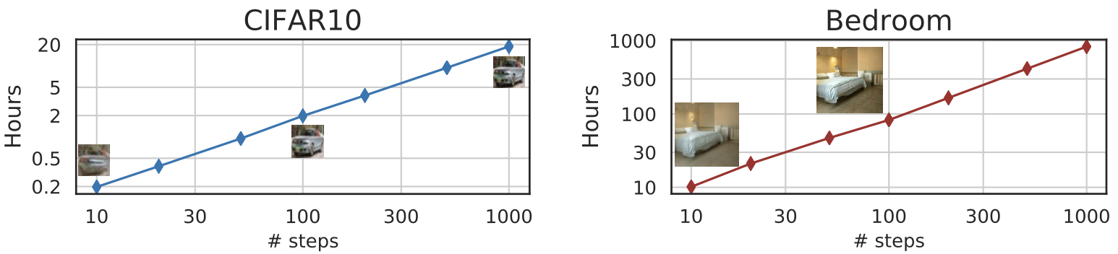
Experiments
Efficiency
Sampling 50K images with 1 Nvidia 2080 Ti GPU
C&I LAB

Slide 40
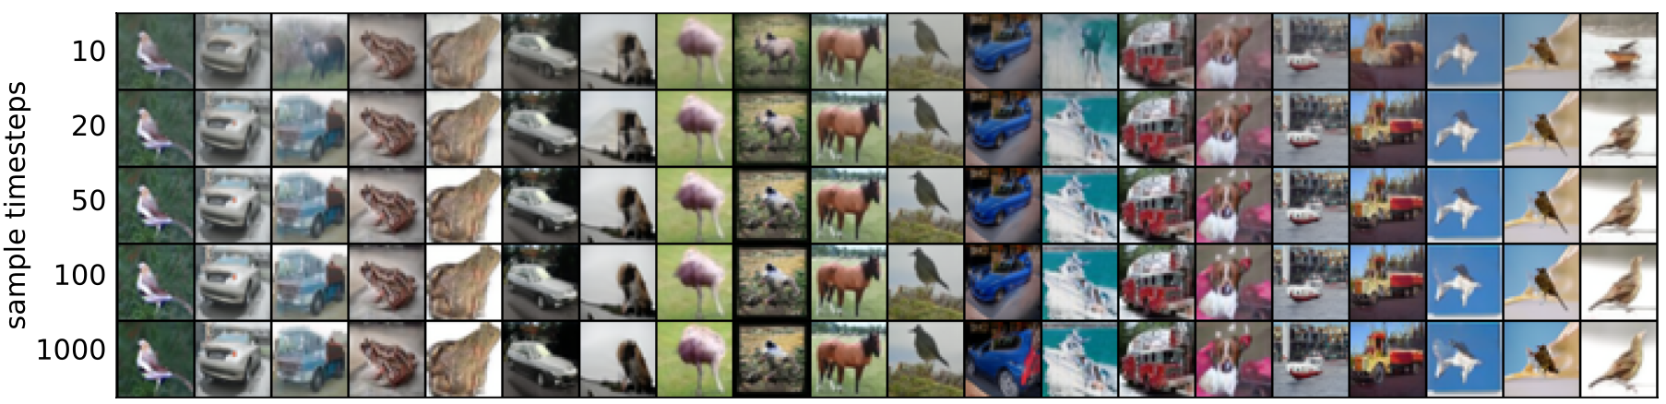
Experiments
Sample Consistency in DDIMs
$x_{T}$ retains high-level features → Similar results despite different generative processes
C&I LAB

Slide 41
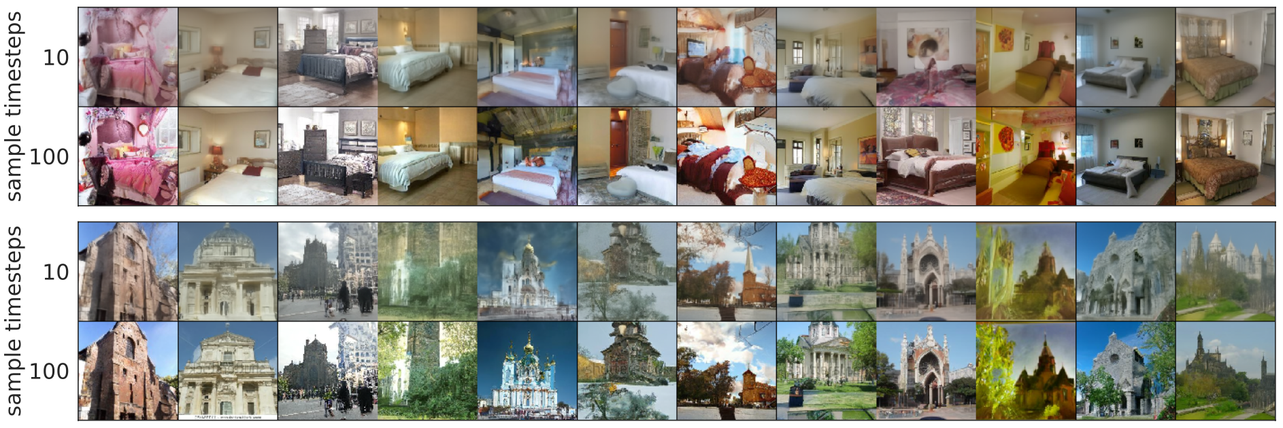
Experiments
Sample Consistency in DDIMs
C&I LAB

Slide 42
Experiments
Interpolation in deterministic generative processes
DDPM : With same $x_{T}$, highly diverse $x_{0}$ is generated (Stochasticity)
DDIM : With same $x_{T}$, the result of $x_{0}$ is expected
Semantic interpolation is possible directly through the latent variables
C&I LAB

Slide 43
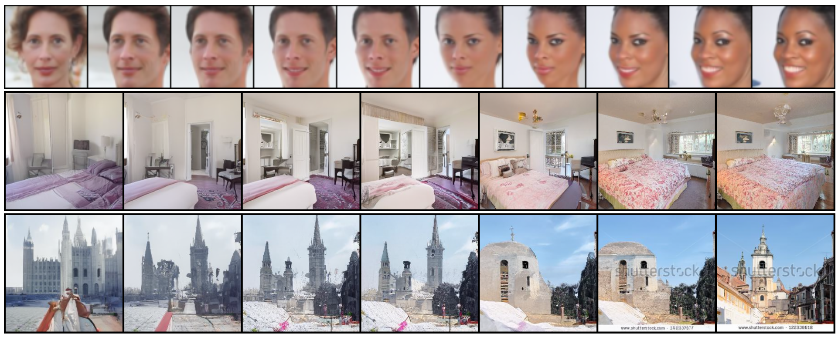
Experiments
Interpolation in deterministic generative processes
C&I LAB

Slide 44
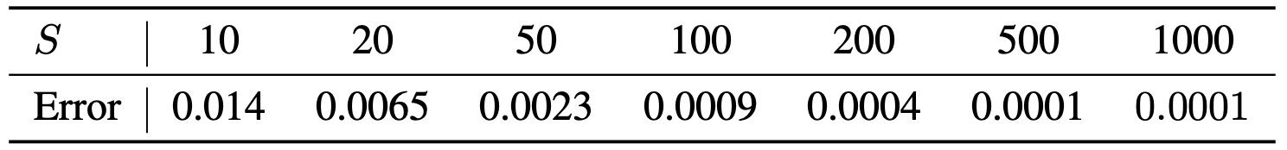
Experiments
Reconstruction From Latent Space
Per-dimension MSE after encoding & decoding with CIFAR-10 test set
C&I LAB

Slide 45
Thank you
C&I LAB

